Slide 1
Was This Time Different? Fiscal Policy in Commodity Republics Luis Felipe Céspedes (UAI) Andrés Velasco (Harvard University & NBER)
10th BIS Annual Conference, 23-24 June 2011

Slide 2
Fiscal policy “should” be countercyclical
According to standard economic theory, fiscal policy should be countercyclical when facing transitory shocks.
In the neoclassical smoothing model of Barro (1979), a government should optimally run surpluses in good times and deficits in bad times (if shocks are perceived as transitory, that is).
That is the same a government should do, though for different reasons, in the standard Keynesian or Neo-Keynesian framework.

Slide 3
…but in practice
Governments often seem to follow a pro-cyclical fiscal policy.
Cuddington (1989), Talvi and Vegh (1995) and Sinnott (2009), among others, document that governments save too little or even disave in booms.
Procyclicality is most evident in Latin America (Gavin et al 1996, Gavin and Perotti 1997, Stein et al 1999) but is also present in OECD countries (Talvi and Vegh 1999, Arreaza et al 1999, Lane 1999 and 2003).

Slide 4
Commodity-rich countries
The problem of procyclicality seems to be especially acute for commodity-rich nations –commodity republics in the nomenclature of this paper.
In those countries commodity-linked revenues (taxes, royalties, profits) can be a large portion of government revenue (see Sinnott 2009). And by any measure, commodity price volatility is large.
As a result, overall revenues are quite volatile –and so can be spending and the fiscal balance.
So much so, that a revenue increase of x% can call forth a spending increase of more than x%, so that deficits rise during commodity price booms.

Slide 5
Mexico in the 1970s and 1980s: an example of procyclicality

Slide 6
The paper
We revisit the issue of fiscal procyclicality in commodity republics.
Given that the behavior of commodity prices is plausibly a main driver of fiscal policy outcomes in these countries, we focus on the behavior of fiscal variables across the commodity cycle.
The paper has two goals:
to document the behavior of fiscal policy for a large number of commodity-producing over a long period of time.
to see whether the behavior of fiscal policy in such countries has changed over time. Was this time different?

Slide 7
Commodity price index and episodes
Using a commodity price index we identify commodity boom episodes.
We define a commodity boom episode as a period in which our domestic production-weighted commodity price index surpasses its historical trend by a certain amount (25%)

Slide 8
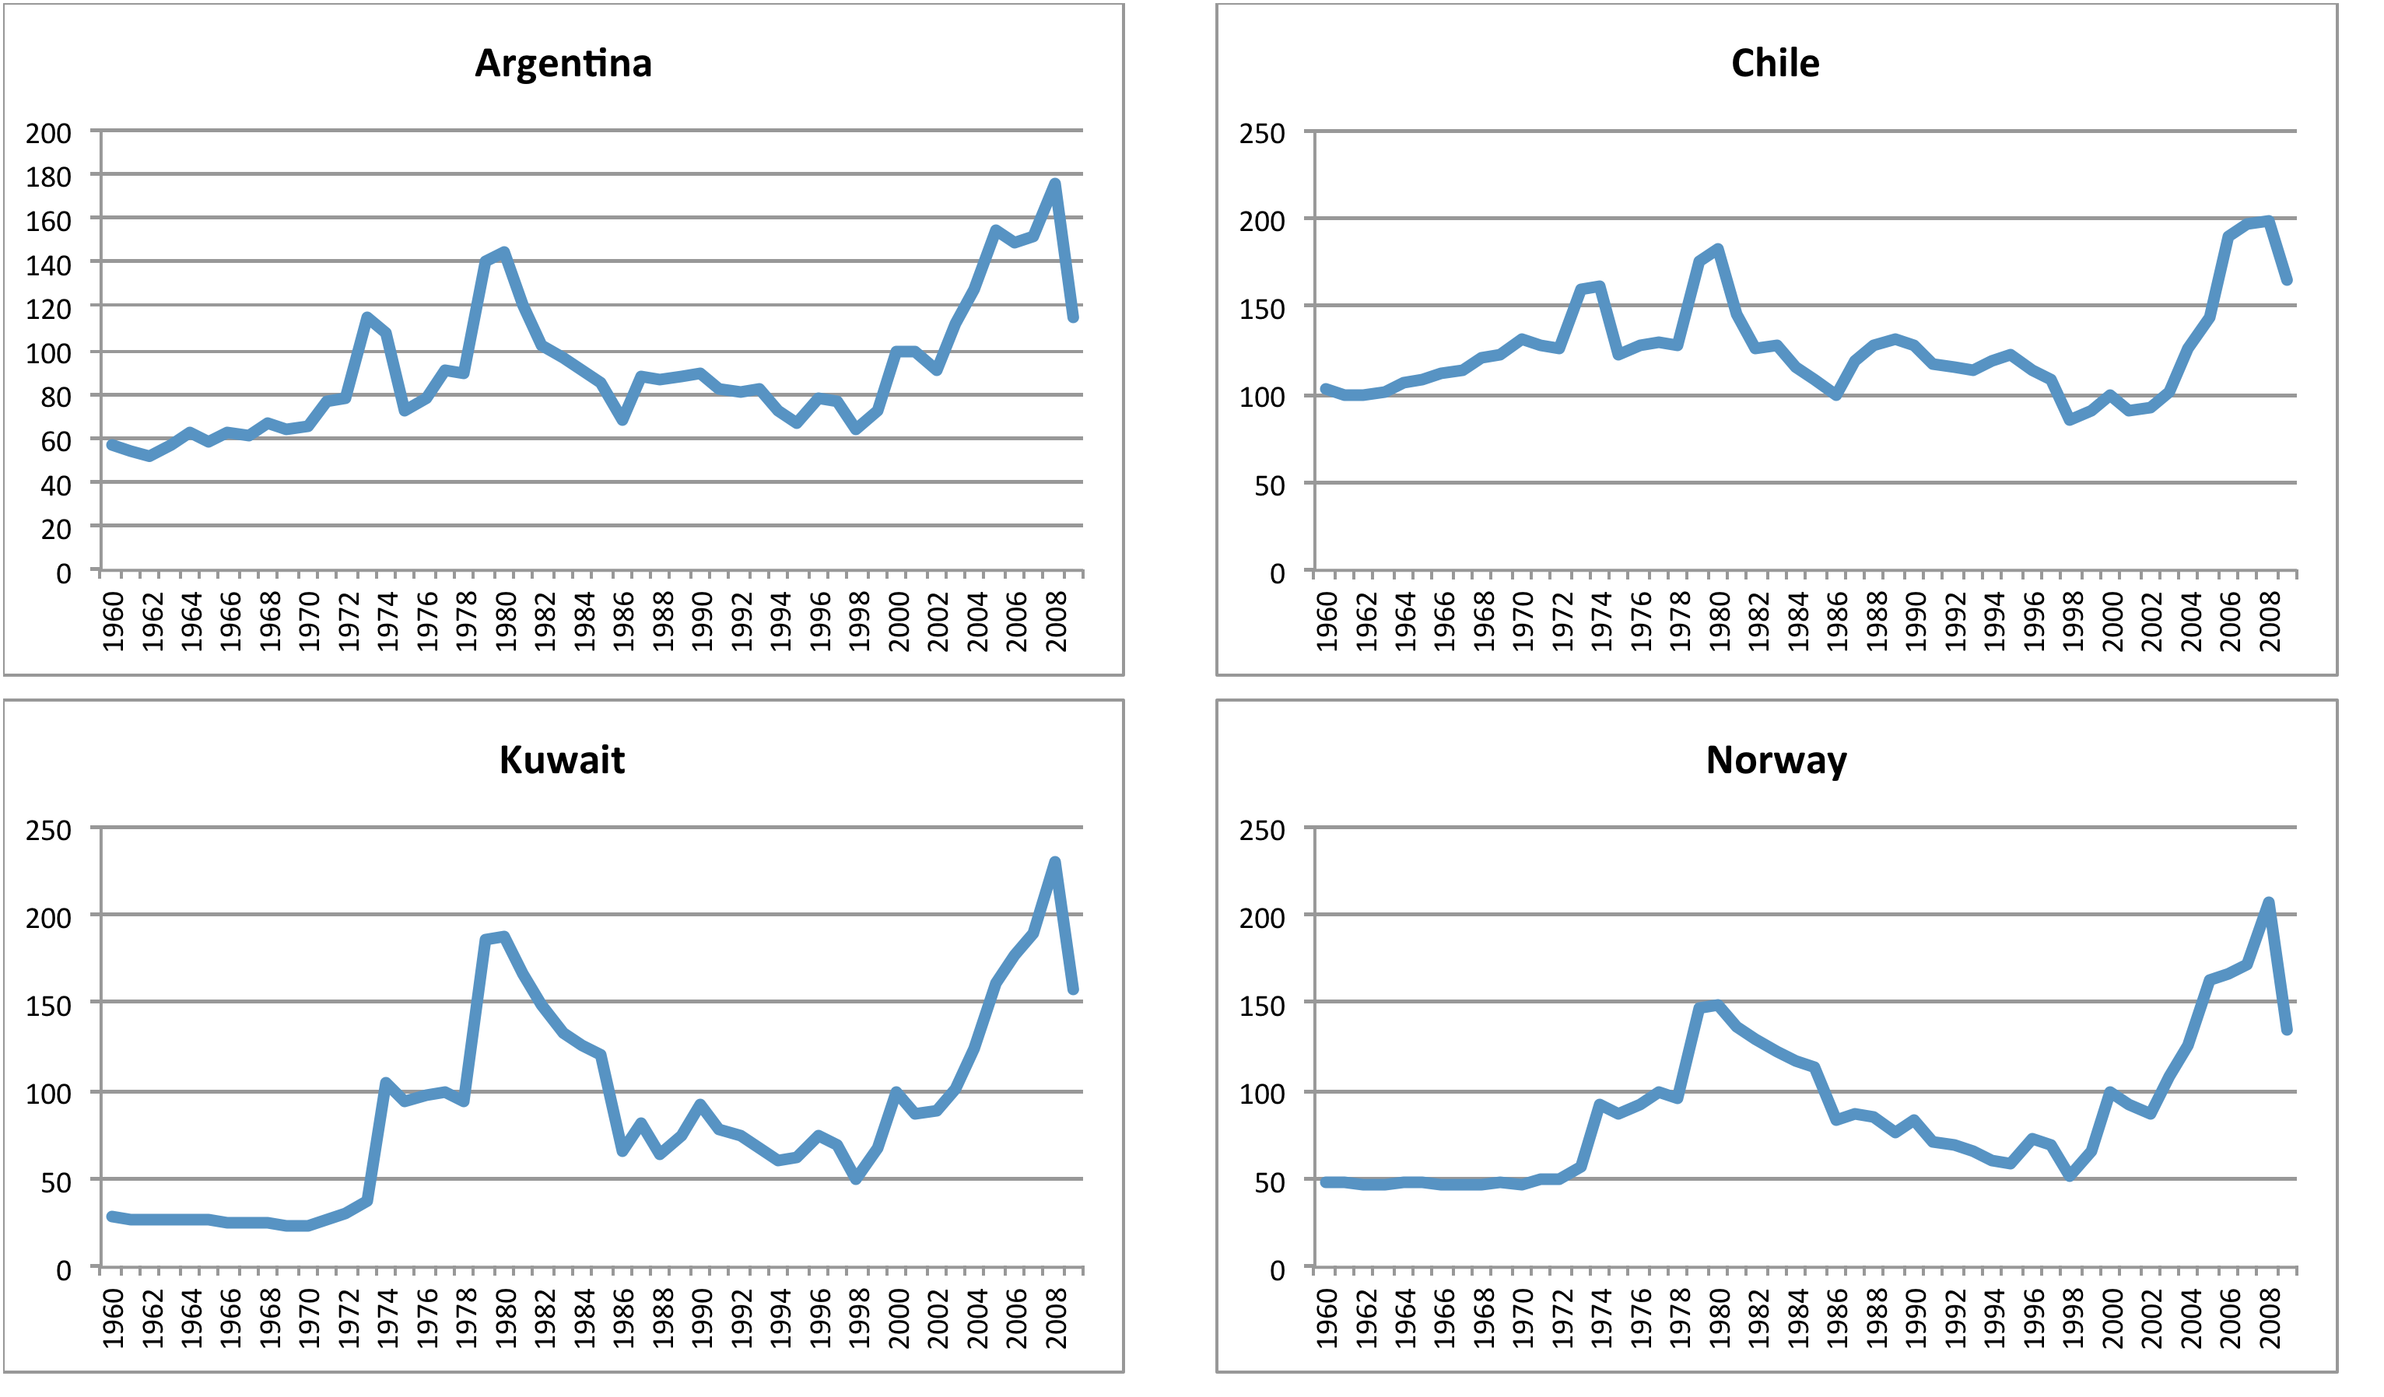
Commodity price index: 2 booms

Slide 9
Commodity prices around episodes
In the episodes before 2000 average commodity price increased 59,9%.
In the recent episode, they increased 59,6%.
By this measure, the two “aggregate episodes” are almost identical.

Slide 10
Episodes
Episodes before 2000 were on average longer than recent episodes.
However, the current boom episode is still ongoing.
We redefine the boom episode as lasting from its beginning to its peak.

Slide 11
Commodity prices around episodes

Slide 12
Fiscal variables around commodity price booms: fiscal balance

Slide 13
Fiscal variables around commodity price booms: government revenues

Slide 14
Fiscal variables around commodity price booms: government expenditures

Slide 15
Fiscal variables around commodity price booms
Figures do suggest that something seems to have been different this time around in terms of the conduct of fiscal policy in times of commodity booms.
But while suggestive, these averages do hide substantial heterogeneity in experiences.
And to be more revealing, individual performances have to be conditioned on the actual change in commodity prices affecting each country.

Slide 16
Cyclicality of fiscal policy I
In the first place, in order to obtain measures of the cyclicality of fiscal policy variables we estimate country-by-country regressions of the form:
For periods 1965-1985 and 1995-2009. Where F corresponds to the fiscal variable under analysis.
This is the same approach to measuring cyclicality adopted by Arreaza et al (1999), Sorensen et al (2001) and Lane (2003).

Slide 17
Cyclicality of fiscal policy I

Slide 18
Cyclicality of fiscal policy II
In a second set of estimations to measure the cyclicality of fiscal policy variables, we estimate country-by-country regressions of the form:
Estimate for periods 1965-1985 and 1995-2009.
This approach has been utilized by Gavin and Perotti (1997) and Alesina et al (2008).
Takes into account that part of the commodity price shock may be more persistent (permanent).

Slide 19
Cyclicality of fiscal policy II

Slide 20
Cyclicality of fiscal policy: summary
The evidence suggests the presence of procyclical fiscal balances in the 1970s and 1980s. The evidence regarding government expenditure is mixed.
The recent episode shows a different pattern. In particular, the evidence we present tends to support the view of a more counter-cyclical stance during the recent commodity boom episode.

Slide 21
What caused the change in fiscal behavior?
Several candidates behind this change:
Political fragmentation (voracity effect)
Fiscal rules
Monetary policy independence
Flexible exchange rates
Learning and lessons from the past

Slide 22
What caused the change in fiscal behavior?
Central bank independence: average number of changes in the central bank governor per year in each decade.
Exchange rate flexibility: Ilzetzki, Reinhart and Rogoff (2008).
Fiscal rule: IMF index
Openness: exports plus imports as % GDP
Political constraint: number of veto points in the political system (Henisz (2000)).

Slide 23
What caused the change in fiscal behavior?

Slide 24
Designing fiscal policy in emerging commodity republics
What can be learnt from the experience of emerging market economies endowed with natural resources?
Under what kind of rule and/or institutional arrangements are diffferent fiscal policy tools effective?
Paper: learning from previous failures and fiscal rules may make a difference
My experience: exactly the same
Chile
Will not to repeat mistakes of the 1970s
Fiscal rule in place since 2001

Slide 25
Chile: fiscal surpluses and the price of copper

Slide 26
Chilean public debt: a long way from Europe

Slide 27
Was This Time Different? Fiscal Policy in Commodity Republics Luis Felipe Céspedes (UAI) Andrés Velasco (Harvard University & NBER)
10th BIS Annual Conference, 23-24 June 2011

